Slide 1


Abstention-Aware Plant Disease Recognition Using Diverse Deep Ensembles and Agentic Evidence Retrieval
VR SIDDHARTHA ENGINEERING COLLEGE, VIJAYAWADA
Department of Computer Science and Engineering
23CS7552: B. Tech Mini Project (0th Review)
August 18, 2026
Batch No: 11
Batch Members
PENUGONDA SANTHOSH KUMAR - (238W1A4253)
SHAIK IRSHAD - (238W1A4256)
Under the Guidance of
Dr. P. SUKANYA
Senior Assistant Professor

Slide 2
Abstract
Plant diseases can substantially reduce crop productivity, particularly when farmers lack timely access to agricultural experts. Although deep-learning systems have achieved high classification accuracy, many are trained and evaluated on controlled images and may produce overconfident predictions when exposed to field photographs, unfamiliar crops, poor lighting, or unseen symptoms. This project proposes a lightweight, evidence-grounded plant-disease screening system that combines diverse deep-learning classifiers with an agentic orchestration layer. Multiple independently trained models analyse the submitted leaf image. A LangGraph workflow aggregates calibrated predictions, measures model agreement, checks image quality and out-of-distribution indicators, and decides whether to provide a disease prediction or abstain. For reliable cases, an evidence agent retrieves relevant agricultural literature and produces a structured explanation covering symptoms, likely causes, preventive practices, and safe next steps with source-linked citations. For uncertain cases, the system clearly reports disagreement and recommends expert verification rather than forcing a diagnosis. Evaluation will compare individual models, majority voting, confidence-based selection, and the proposed abstention mechanism on laboratory and independent field datasets. A Streamlit interface will demonstrate accessible deployment for farmers, students, and agricultural extension workers.

Slide 3
Keywords:
Plant disease detection, deep learning, model disagreement, uncertainty-aware AI, abstention, evidence-grounded retrieval, precision agriculture

Slide 4
1. Research Domain
Primary Domain: Artificial Intelligence and Machine Learning
Sub-Domain: Computer Vision, Deep Learning, Uncertainty Quantification, and Agentic AI
Application Area: Precision Agriculture and Plant Disease Detection

Slide 5
2. SDG Categories
SDG 2: Zero Hunger
The project directly supports sustainable food production by enabling early and reliable plant-disease detection, which can reduce crop losses and improve agricultural productivity for smallholder farmers.
SDG 9: Industry, Innovation and Infrastructure
The project develops accessible AI infrastructure for agriculture through a lightweight, deployable system that can be used by farmers and agricultural extension workers via mobile devices.
SDG 12: Responsible Consumption and Production
By providing evidence-grounded recommendations and preventing unnecessary pesticide use through reliable disease screening, the system promotes sustainable agricultural practices and reduces environmental impact.

Slide 6
3. Aim and Motivation
Aim:
To design and evaluate a field-aware abstention policy for plant-disease screening that combines multi-model disagreement, calibrated confidence, image-quality assessment, and evidence-grounded validation. And deploy a lightweight Streamlit interface that provides reliable predictions when confidence is high and recommends expert verification when uncertainty is detected.
Motivation:
Plant diseases cause approximately 220 billion USD in annual agricultural losses, and early detection is critical for food security.
Existing deep-learning systems achieve high accuracy on controlled datasets but often fail on real field photographs due to domain shift, background bias, and varying image.
Most systems force a prediction on every image, even when models are uncertain, which can lead to harmful recommendations such as incorrect pesticide use or delayed treatment.
Farmers and agricultural students need a trustworthy screening tool that knows when to abstain and seek expert verification rather than providing overconfident but unreliable diagnoses.

Slide 7
4. Research Questions
Can a plant-disease screening system that abstains on uncertain images provide safer and more reliable assistance than existing systems that force predictions on all images?
How does combining multi-model disagreement, calibrated confidence, and image-quality assessment affect selective accuracy and coverage on field-domain images?
Can evidence-grounded retrieval improve the reliability of predictions by validating or rejecting uncertain diagnoses before they are shown to users?

Slide 8
5. Title Justification
Abstention-Aware highlights the core research contribution: deciding when to refuse a prediction rather than forcing one.
Diverse Deep Ensembles indicates the use of multiple complementary models rather than a single classifier.
Agentic Evidence Retrieval shows that the system retrieves and validates agricultural evidence as part of the decision process, not just for explanation.

Slide 9
6. Objectives
To implement a multi-model plant-disease screening system with calibrated confidence and image-quality assessment.
To design and evaluate an abstention policy that refuses predictions on uncertain or out-of-distribution images.
To integrate evidence-grounded retrieval that validates predictions before they are shown to users.
To deploy a lightweight Streamlit interface for real-world accessibility by farmers and agricultural students.

Slide 10
7. Scope
The system will focus on a limited number of crop types and disease classes for the initial implementation to ensure reliable performance and manageable evaluation.
The Streamlit deployment will provide an accessible web interface that allows farmers, students, and agricultural extension workers to upload leaf images and receive disease screening results with evidence-grounded explanations.
The project will report reliability metrics including selective accuracy, expected calibration error, risk-coverage curves, and abstention rate in addition to standard accuracy, precision, recall, and F1 scores.

Slide 11
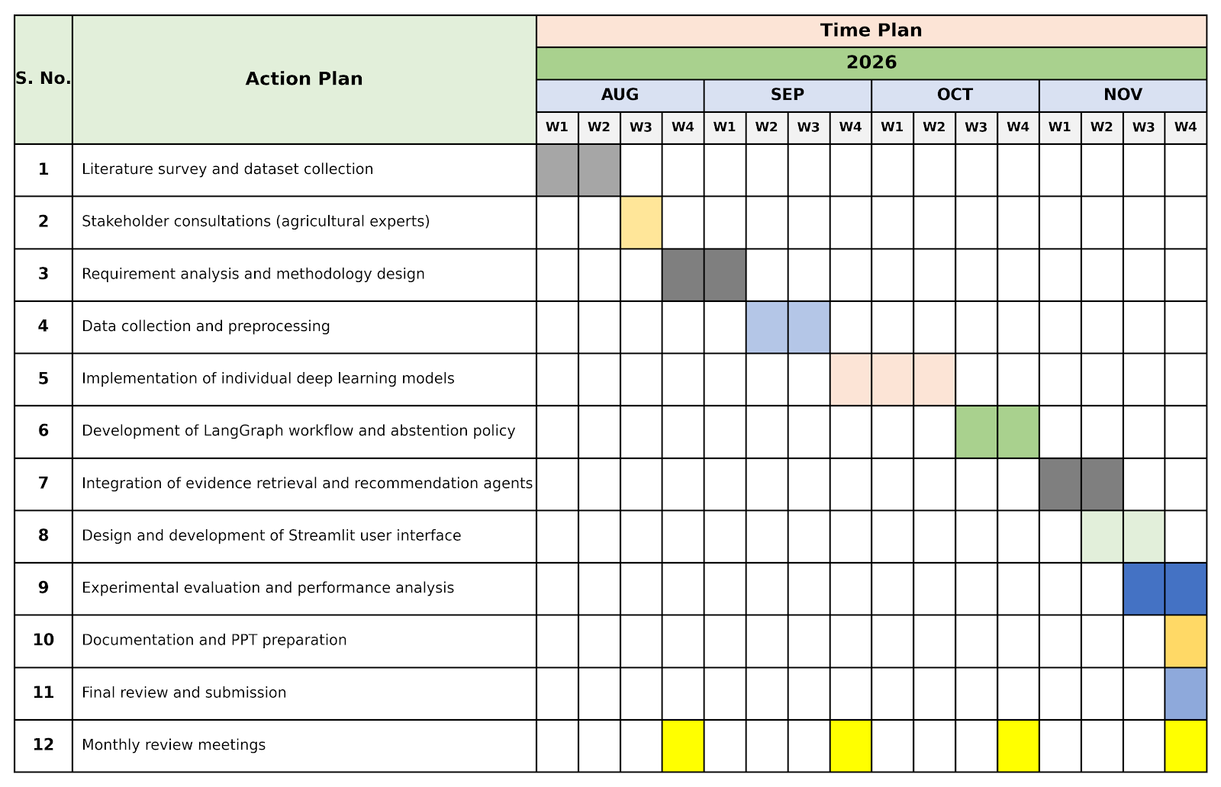
8. Timeline Chart

Slide 12
9. Project Outcomes
EPICS
Title: Multi-lingual voice assisted skin disease classification using transformers
Types: Conference
Name of Conference: 2026 IEEE 4th International Conference on Communication, Security, and Artificial Intelligence
Status: Submitted

Slide 13
10.1 Study on Existing Technologies
Title: A Review of Plant Leaf Disease Identification by Deep Learning Algorithms
Journal Details: Frontiers in Plant Science, Vol. 16, Article 1637241, Frontiers Media SA, 2025.
Dataset: Review paper; PlantVillage, PlantDoc, AI Challenger, and crop-specific datasets.
Description:
Reviews CNNs, transfer learning, attention mechanisms, Transformers, image augmentation, and public plant disease datasets. It emphasizes the difference between controlled benchmark images and real field images.
Gaps Addressed:
Summarizes deep-learning architectures for leaf disease identification.
Highlights the need for field-image datasets and better generalization.
Limitations:
Does not implement a specific disease-recognition model.
Does not handle uncertainty, unknown diseases, or safe abstention.

Slide 14
10.2 Study on Existing Technologies
Title: Machine Learning and Deep Learning for Plant Disease Detection: A Review of Techniques and Trends
Journal Details: International Journal of Science and Innovation, 2025.
Dataset: Review paper; discusses PlantVillage, PlantDoc, and custom crop-disease datasets.
Description:
Reviews ML and DL methods for plant disease detection, including SVM, Random Forest, CNNs, transfer learning, EfficientNet, ResNet, MobileNet, and YOLO models. It highlights high benchmark accuracy but reduced field reliability.
Gaps Addressed:
Reviews the evolution from ML to modern deep-learning methods.
Identifies dataset bias and real-time deployment issues.
Limitations:
Does not propose an abstention mechanism for uncertain disease images.
Does not provide an ensemble, OOD detection, or evidence-retrieval framework.

Slide 15
10.3 Study on Existing Technologies
Title: ConvGeM-next: A Deep Learning Framework for Plant Disease Detection
Journal Details: Frontiers in Plant Science, Vol. 17, Article 1763739, Frontiers Media SA, 2026. DOI: 10.3389/fpls.2026.1763739
Dataset: PlantVillage — 54,284 images, 38 classes
PlantDoc — approximately 2,598 images, 27 classes.
Description:
Proposes ConvGeM-NeXt using ConvNeXt-Base, Generalized Mean Pooling, and transfer learning. It captures fine lesion features and achieved 99.65% accuracy on PlantVillage and 94.69% on PlantDoc.
Gaps Addressed:
Improves local lesion-feature extraction using Generalized Mean Pooling.
Evaluates on both controlled and field-style disease datasets.
Limitations:
Always returns one disease label, even for uncertain inputs.
Uses a heavy model that may be difficult for low-resource deployment.
Does not use ensemble disagreement or evidence retrieval.

Slide 16
10.4 Study on Existing Technologies
Title: Advancing Plant Disease Classification Using an Attention-Based CNN for Intra-Dataset and Cross-Dataset Training
Journal Details: Scientific Reports, Vol. 16, Article 45464, Nature Portfolio, 2026. DOI: 10.1038/s41598-026-45464-7
Dataset: PlantVillage, PlantDoc, Digipathos, Northern Leaf Blight, and CD&S datasets.
Description:
Introduces an attention-based CNN for corn and potato disease classification. It achieved 99.38% accuracy on PlantVillage potato images and 82.93% average accuracy in cross-dataset corn evaluation.
Gaps Addressed:
Uses attention to focus on disease-relevant leaf regions.
Evaluates cross-dataset performance instead of only same-dataset accuracy.
Limitations:
Does not abstain when domain shift reduces prediction reliability.
Uses one attention-CNN model rather than diverse deep models.
Does not retrieve verified disease-management evidence.

Slide 17
10.5 Study on Existing Technologies
Title: AI Based Real Time Disease Diagnosis in Plants Using Deep Learning Driven CNNs
Journal Details: Scientific Reports, Vol. 16, Article 4587, Nature Portfolio, 2026. DOI: 10.1038/s41598-025-34681-1
Dataset: 42,860 images from tomato, potato, maize, grape, and pepper crops.
Description:
Proposes PDD-DL, a CNN-based real-time plant disease diagnosis model. The model achieved 98.32% accuracy and approximately 42.6 ms inference time per image.
Gaps Addressed:
Supports fast disease detection for mobile and edge deployment.
Uses image augmentation to improve CNN robustness.
Limitations:
Gives a prediction for every image without uncertainty-based abstention.
Does not identify unknown diseases or non-leaf images.
Does not validate agricultural advice through trusted evidence sources.

Slide 18
10.6 Study on Existing Technologies
Title: A Diversity-Optimized Deep Ensemble Approach for Accurate Plant Leaf Disease Detection
Journal Details: arXiv Preprint, arXiv:2511.16982, 2025.
Dataset: Plant leaf disease dataset containing healthy and diseased leaf classes.
Description:
Introduces Synergistic Diversity for selecting deep models that are individually accurate and collectively complementary. The method aims to build better ensembles than those selected using conventional diversity metrics.
Gaps Addressed:
Addresses poor ensemble selection based only on model accuracy.
Promotes useful model diversity for improved plant disease prediction.
Limitations:
Focuses mainly on higher classification accuracy.
Does not provide conformal prediction or formal abstention.
Does not include OOD detection or evidence-grounded response generation.

Slide 19
10.7 Study on Existing Technologies
Title: Uncertainty-Aware Transformers-Conformal Prediction for Language Models
Journal Details: Research paper on uncertainty-aware Transformer models and conformal prediction.
Dataset: Language-model datasets; not a plant leaf disease dataset
Description:
Studies conformal prediction for uncertainty-aware Transformer outputs. It produces prediction sets with statistical reliability guarantees instead of always selecting one label.
Gaps Addressed:
Provides a formal method for measuring predictive uncertainty.
Supports selective prediction and abstention for unreliable outputs.
Limitations:
Designed for language models, not plant disease image classification.
Requires adaptation to CNN or vision-ensemble probability outputs.
Does not address agricultural datasets, field images, or disease evidence retrieval.

Slide 20
10.8 Study on Existing Technologies
Title: Agentic AI for Smart and Sustainable Precision Agriculture
Journal Details: Frontiers in Plant Science, Vol. 16, Article 1706428, Frontiers Media SA, 2026. DOI: 10.3389/fpls.2025.1706428
Dataset: Tomato disease classification and weed detection datasets
Description:
Presents an Agentic AI framework integrating intelligent agents, federated learning, DenseNet121, MobileNetV2, EfficientDet-D0, and YOLOv8 for precision agriculture. The federated tomato disease model achieved 96.4% accuracy.
Gaps Addressed:
Supports distributed farm intelligence and privacy-aware learning.
Uses multiple AI models for disease and weed monitoring.
Limitations:
Focuses on federated agriculture rather than abstention-aware diagnosis.
Does not use conformal prediction or ensemble disagreement.
Does not provide disease-specific evidence retrieval and validation.

Slide 21
10.9 Study on Existing Technologies
Title: Recent Advances in Plant Disease Detection: Challenges and Future Directions
Journal Details: Plant Methods, Vol. 21, BMC / Springer Nature, 2025. DOI: 10.1186/s13007-025-01450-0
Dataset: Review paper; analyzes 11 benchmark datasets and field-deployment conditions
Description:
Reviews RGB imaging, hyperspectral imaging, CNNs, Transformers, and disease datasets. It reports that laboratory accuracy is often 95%–99%, while real field deployment may fall to approximately 70%–85%.
Gaps Addressed:
Identifies the major laboratory-to-field performance gap.
Discusses imaging cost, field robustness, interpretability, and deployment issues.
Limitations:
Does not propose a working uncertainty-aware disease model.
Does not provide a selective prediction or abstention policy.
Does not integrate model prediction with evidence retrieval.

Slide 22
10.10 Study on Existing Technologies
Title: Rethinking Plant Disease Diagnosis: Bridging the Academic-Practical Gap with Vision Transformers and Zero-Shot Learning
Journal Details: arXiv Preprint, arXiv:2511.18989, 2025.
Dataset: PlantVillage and field-oriented plant disease image data.
Description:
Compares CNNs, Vision Transformers, and CLIP-style zero-shot models for plant disease diagnosis. It shows that high controlled-dataset accuracy may not transfer well to real field images.
Gaps Addressed:
Highlights the gap between academic datasets and real farm conditions.
Explores Vision Transformers and zero-shot learning for better generalization.
Limitations:
Does not use a diverse ensemble of CNN and Transformer models.
Does not implement conformal abstention for uncertain cases.
Does not include a retrieval-based agricultural evidence module.

Slide 23
10.11 Study on Existing Technologies
Title: MRC-Net: A Reliable Plant Disease Classification Framework with Multi-Frequency State-Space Enhancement and Conformal Prediction
Journal Details: Frontiers in Plant Science, Vol. 17, Article 1895287, Frontiers Media SA, 2026. DOI: 10.3389/fpls.2026.1895287
Dataset: NGLD, PlantVillage, and PlantDoc datasets.
Description:
Proposes MRC-Net using a Swin-Tiny Transformer, multi-frequency feature enhancement, and conformal prediction. It generates reliable prediction sets rather than only forced single-label predictions.
Gaps Addressed:
Introduces conformal prediction for reliable plant disease classification.
Uses multi-frequency features for global leaf appearance and local lesion details.
Limitations:
Uses one main Transformer model rather than a diverse deep ensemble.
Shows reduced field-style performance on PlantDoc images.
Does not provide agentic evidence retrieval after accepting a diagnosis.

Slide 24
10.12 Study on Existing Technologies
Title: Enhancing Anomaly Detection in Plant Disease Recognition with Knowledge Ensemble
Journal Details: Frontiers in Plant Science, Vol. 16, Frontiers Media SA, 2025. DOI: 10.3389/fpls.2025.1623907
Dataset: Plant disease datasets with known disease classes and unknown or anomalous test images.
Description:
Presents a knowledge-ensemble method for detecting anomalous plant disease images. It combines prediction confidence, domain-specific knowledge, and general visual knowledge to separate known diseases from unfamiliar inputs.
Gaps Addressed:
Addresses unknown disease and out-of-distribution image detection.
Reduces unsafe classification of non-leaf, unfamiliar, or abnormal images.
Limitations:
Focuses mainly on anomaly detection rather than final disease diagnosis.
Does not combine deep-model disagreement with conformal prediction.
Does not provide evidence-grounded agricultural explanations.

Slide 25
10. Study on Existing Technologies — I
Table no. 1: Summary of existing implementations
S. No. | Article Title | Journal Details | Algorithms / Models | Datasets | Gaps Addressed | Limitations
1 | Machine Learning and Deep Learning for Plant Disease Detection: A Review of Techniques and Trends | International Journal of Science and Innovation, 2025 | SVM, Random Forest, CNN, ResNet, MobileNet, EfficientNet, YOLO | PlantVillage, PlantDoc, custom datasets | 1. Reviews ML/DL approaches for plant disease detection. 2. Identifies dataset and deployment challenges. | 1. Limited real-field generalization. 2. No integrated abstention or OOD handling.
2 | A Review of Plant Leaf Disease Identification by Deep Learning Algorithms | Frontiers in Plant Science, Vol. 16, Article 1637241, 2025 | CNNs, transfer learning, attention, Transformers | PlantVillage, PlantDoc, AI Challenger, crop-specific datasets | 1. Summarizes deep-learning methods for leaf disease identification. 2. Discusses emerging architectures. | 1. Review-based, not a deployable model. 2. No integrated uncertainty-aware abstention.
3 | ConvGeM-next: A Deep Learning Framework for Plant Disease Detection | Frontiers in Plant Science, Vol. 17, Article 1763739, 2026 | ConvNeXt-Base, Generalized Mean Pooling, transfer learning | PlantVillage, PlantDoc | 1. Combines deep feature extraction and pooling. 2. Evaluates controlled and field-style images. | 1. Computationally demanding architecture. 2. Forced predictions. 3. No ensemble uncertainty or evidence retrieval.
25

Slide 26
10. Study on Existing Technologies — II
Table no. 2: Summary of existing implementations
S. No. | Article Title | Journal Details | Algorithms / Models | Datasets | Gaps Addressed | Limitations
4 | Advancing Plant Disease Classification Using an Attention-Based CNN for Intra-Dataset and Cross-Dataset Training | Scientific Reports, Vol. 16, Article 45464, 2026 | Attention-based CNN | PlantVillage, PlantDoc, Digipathos, Northern Leaf Blight, CD&S | 1. Focuses on disease-region features. 2. Studies cross-dataset performance. | 1. Single-model approach. 2. No abstention mechanism. 3. No evidence-based advisory.
5 | AI Based Real Time Disease Diagnosis in Plants Using Deep Learning Driven CNNs | Scientific Reports, Vol. 16, Article 4587, 2026 | PDD-DL CNN, batch normalization, dropout, softmax | 42,860 images covering tomato, potato, maize, grape, and pepper | 1. Develops CNN-based disease diagnosis. 2. Focuses on rapid prediction. | 1. Forced predictions for uncertain inputs. 2. Limited OOD detection. 3. No evidence validation.
6 | A Diversity-Optimized Deep Ensemble Approach for Accurate Plant Leaf Disease Detection | 2025 IEEE International Conference on Big Data (BigData), 2025 | Deep ensembles, Synergistic Diversity, ensemble selection | Plant leaf disease image dataset | 1. Uses model diversity to select complementary ensemble members. 2. Focuses on ensemble-based classification. | 1. No integrated conformal abstention. 2. No OOD-aware evidence retrieval.
26

Slide 27
10. Study on Existing Technologies — III
Table no. 3: Summary of existing implementations
S. No. | Article Title | Journal Details | Algorithms / Models | Datasets | Gaps Addressed | Limitations
7 | Uncertainty-Aware Transformers: Conformal Prediction for Language Models | Transactions on Machine Learning Research (TMLR), under review | Transformers, conformal prediction, prediction sets | Language-model datasets | 1. Studies uncertainty estimation. 2. Explores prediction sets for reliable outputs. | 1. Focuses on language models. 2. Requires adaptation to plant-image classification. 3. No agricultural evidence retrieval.
8 | Agentic AI for Smart and Sustainable Precision Agriculture | Frontiers in Plant Science, Vol. 16, Article 1706428, 2026 | Agentic AI, federated learning, DenseNet121, MobileNetV2, EfficientDet-D0, YOLOv8 | Tomato disease and weed-detection datasets | 1. Explores agentic workflows in agriculture. 2. Studies distributed learning for agricultural monitoring. | 1. No integrated conformal abstention. 2. Limited uncertainty-aware diagnosis. 3. No dedicated disease-evidence validation workflow.
9 | Recent Advances in Plant Disease Detection: Challenges and Future Directions | Plant Methods, Vol. 21, 2025 | Classical ML, CNNs, Vision Transformers, RGB and hyperspectral imaging | Review of 11 plant-disease datasets | 1. Reviews detection methods and dataset challenges. 2. Examines field generalization and deployment. | 1. Review-based, not an implemented prediction system. 2. No integrated selective prediction or agentic retrieval.
27

Slide 28
10. Study on Existing Technologies — IV
Table no. 4: Summary of existing implementations
S. No. | Article Title | Journal Details | Algorithms / Models | Datasets | Gaps Addressed | Limitations
10 | Rethinking Plant Disease Diagnosis: Bridging the Academic-Practical Gap with Vision Transformers and Zero-Shot Learning | arXiv preprint, arXiv:2511.18989, 2025 | CNNs, Vision Transformers, CLIP, zero-shot learning | PlantVillage and field-oriented images | 1. Studies the gap between laboratory and practical diagnosis. 2. Explores zero-shot disease recognition. | 1. Limited ensemble uncertainty estimation. 2. No conformal abstention. 3. No integrated evidence retrieval.
12 | MRC-Net: A Reliable Plant Disease Classification Framework with Multi-Frequency State-Space Enhancement and Conformal Prediction | Frontiers in Plant Science, Vol. 17, Article 1895287, 2026 | Swin-Tiny Transformer, multi-frequency state-space enhancement, conformal prediction | NGLD, PlantVillage, PlantDoc | 1. Combines enhanced feature extraction with conformal prediction. 2. Produces prediction sets for classification. | 1. Relies on a primary architecture. 2. Field-style generalization remains challenging. 3. No agentic evidence retrieval.
13 | Enhancing Anomaly Detection in Plant Disease Recognition with Knowledge Ensemble | Frontiers in Plant Science, Vol. 16, 2025 | Knowledge ensemble, confidence scoring, domain-specific and general visual knowledge, OOD detection | Known-disease and unknown/anomalous images | 1. Uses complementary visual knowledge for anomaly detection. 2. Addresses recognition of previously unseen inputs. | 1. Primarily focuses on anomaly detection. 2. No integrated conformal abstention. 3. No evidence-grounded diagnostic response.
28

Slide 29
11. Gap Analysis
Existing plant disease classification models primarily focus on prediction accuracy, with limited emphasis on reliable decisions under uncertainty.
Many approaches rely on a single model, limiting the use of complementary features and disagreement between diverse architectures.
Models trained on controlled datasets such as PlantVillage may not generalize effectively to field images with varying lighting, backgrounds, and disease severity.
Unknown diseases and out-of-distribution (OOD) images remain challenging, with limited integration of uncertainty estimation and abstention mechanisms.
Prediction confidence alone may not guarantee reliable outputs, highlighting the need for calibrated uncertainty and selective prediction with measurable coverage and accuracy.
Existing approaches often lack an integrated agentic evidence-retrieval mechanism to support predictions with relevant, traceable disease information.

Slide 30
12. SDLC Model
1
1
Problem Definition
Need for reliable recognition with uncertainty handling, abstention and evidence support
7
Testing &
Improvement
Problem
Definition
7
Testing and Improvement
Test correct, uncertain and unfamiliar inputs; refine models, thresholds, retrieval
2
2
Data Collection
Leaf images from PlantVillage and other public datasets for generalization checks
System
Integration
Machine Learning
life-cycle
Feedback loop: 7 → 4
Data
Collection
6
System Integration
Ensemble with uncertainty-aware abstention and agentic evidence retrieval
6
3
Data Preparation
Verify labels and integrity, resize to 224 × 224, preprocess, augment, split train/val/test
3
5
Model Evaluation
Accuracy, precision, recall, F1, confusion matrices, agreement, uncertainty, abstention metrics
Model
Evaluation
Data
Preparation
4
Model Development
Train and compare ConvNeXt, EfficientNet, ResNet and transformer-based models
5
Model
Development
4
Figure 1. Iterative Machine Learning Life Cycle for Abstention-Aware Plant Disease Recognition.
Source: Adapted from TutorialsPoint, “Machine Learning Life Cycle,” https://www.tutorialspoint.com/machine_learning/machine_learning_life_cycle.htm
30

Slide 31
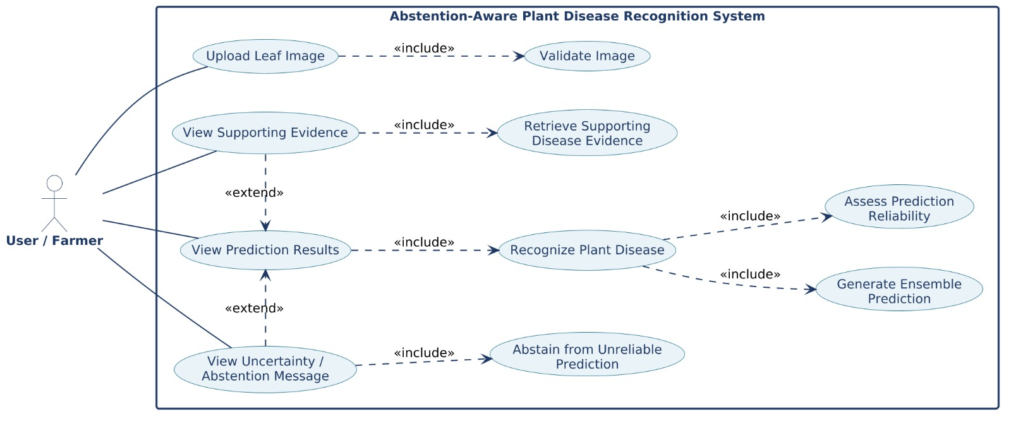
13.1. Use Case Diagram
Figure 13.1: Use Case Diagram of Abstention-Aware Plant Disease Recognition Using Diverse Deep Ensembles and Agentic Evidence Retrieval.

Slide 32
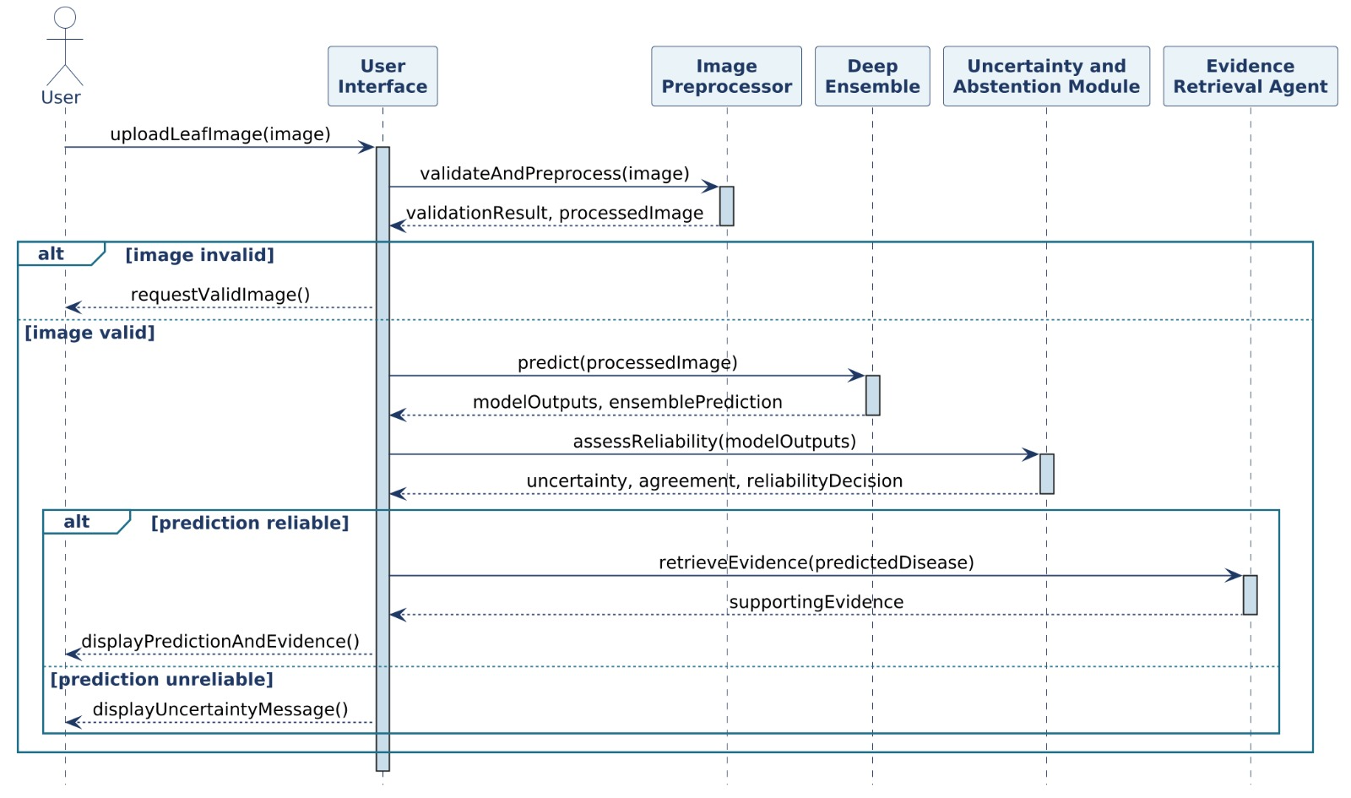
13.2. Sequence Diagram
Figure 13.2: Sequence Diagram of Abstention-Aware Plant Disease Recognition Using Diverse Deep Ensembles and Agentic Evidence Retrieval.

Slide 33
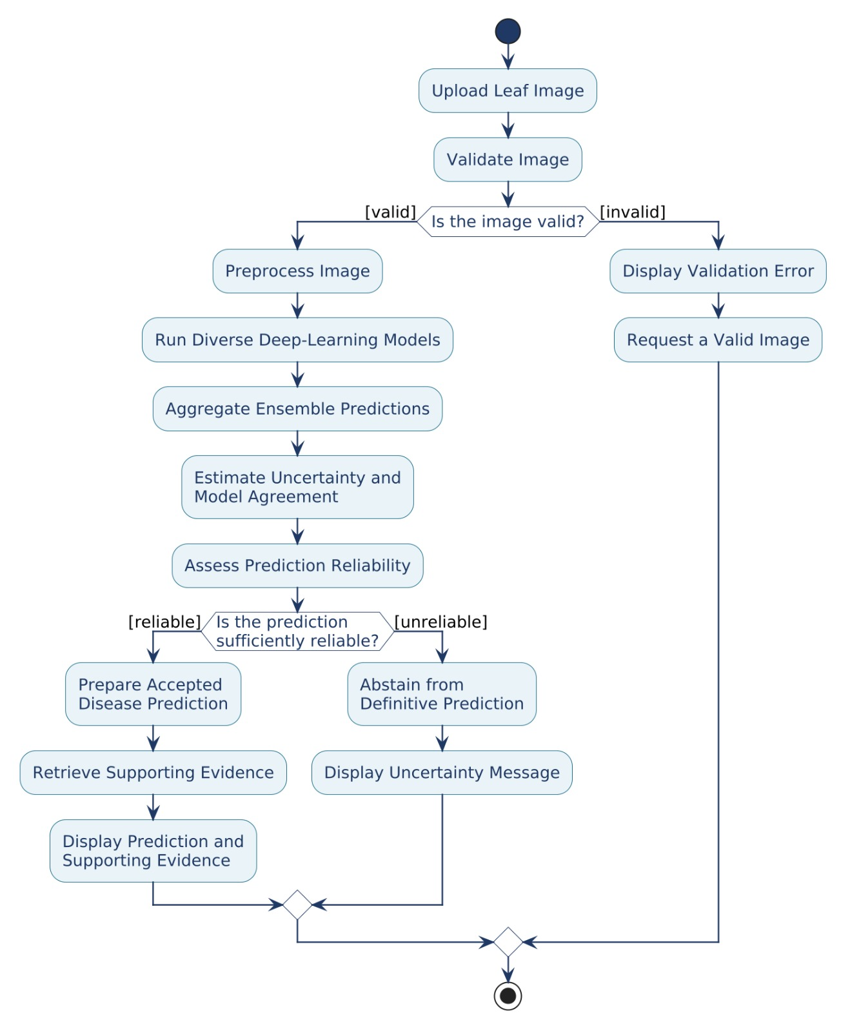
13.3. Activity Diagram
Figure 13.3: Activity Diagram of Abstention-Aware Plant Disease Recognition Using Diverse Deep Ensembles and Agentic Evidence Retrieval.

Slide 34
14. Functional and Non-Functional Requirements
Table 14.1. Functional Requirements of the Proposed System.
ID | Requirement Category | Requirement Description
FR1 | Image Input | The system shall allow the user to upload a plant leaf image in a supported image format.
FR2 | Image Validation | The system shall check that the uploaded image is readable and in an accepted format.
FR3 | Image Preprocessing | The system shall preprocess valid images into the input format required by the trained models.
FR4 | Disease Classification | The system shall generate disease-class predictions using the selected trained model or ensemble.
FR5 | Ensemble Prediction | Where multiple models are integrated, the system shall aggregate their outputs per the ensemble strategy.
FR6 | Reliability Assessment | The system shall evaluate configured reliability indicators (model agreement, uncertainty) where implemented.
FR7 | Abstention | The system shall not present a definitive prediction when configured reliability criteria are not met.
FR8 | Evidence Retrieval | The system shall retrieve relevant plant disease information through the evidence-retrieval component.
FR9 | Result Presentation | The system shall display the accepted prediction with available evidence, or an abstention message.
FR10 | Input Error Handling | The system shall show an error or retry message when the input image is invalid or unprocessable.

Slide 35
14. Functional and Non-Functional Requirements
Table 14.2. Non-Functional Requirements of the Proposed System.
ID | Requirement Category | Requirement Description
NFR1 | Performance | Preprocessing, inference, reliability assessment and result generation should complete in reasonable time.
NFR2 | Reliability | The system should handle invalid inputs and processing failures without an unsupported definitive result.
NFR3 | Prediction Transparency | The system should distinguish accepted predictions from abstentions and show uncertainty information.
NFR4 | Maintainability | Models, thresholds and evidence-retrieval components should be updatable without restructuring the application.
NFR5 | Usability | The interface should let a user submit a leaf image and understand the prediction, evidence or abstention.
NFR6 | Compatibility | The system should support the image formats, input dimensions and environment set by the implementation.
NFR7 | Reproducibility | Evaluation should use documented dataset splits, preprocessing settings, model configurations and procedures.
NFR8 | Resource Efficiency | Model training and inference should remain compatible with the available computing resources.
NFR9 | Data Integrity | The system should preserve correct image–label associations during data preparation and evaluation.
NFR10 | Evidence Traceability | Retrieved evidence should include source details where the retrieval mechanism supports them.

Slide 36
15. Data Collection
Name of the Dataset: PlantVillage Dataset
Source: Kaggle — tushar5harma/plant-village-dataset-updated
Description: Labeled plant leaf images of healthy and diseased plant conditions, used in this project for plant disease classification. The current inspection found zero corrupted images, and all three splits contain all 29 classes.
Plant Species (9): Apple, Bell Pepper, Cherry, Corn (Maize), Grape, Peach, Potato, Strawberry, Tomato
Classes: 29
Number of Images: 67,118
Train set size: 53,693 (Predefined)
Validation set size: 12,067 (Predefined)
Test set size: 1,358 (Predefined)
Image resolution: 224 × 224 pixels after preprocessing (original image dimensions may vary)

Slide 37
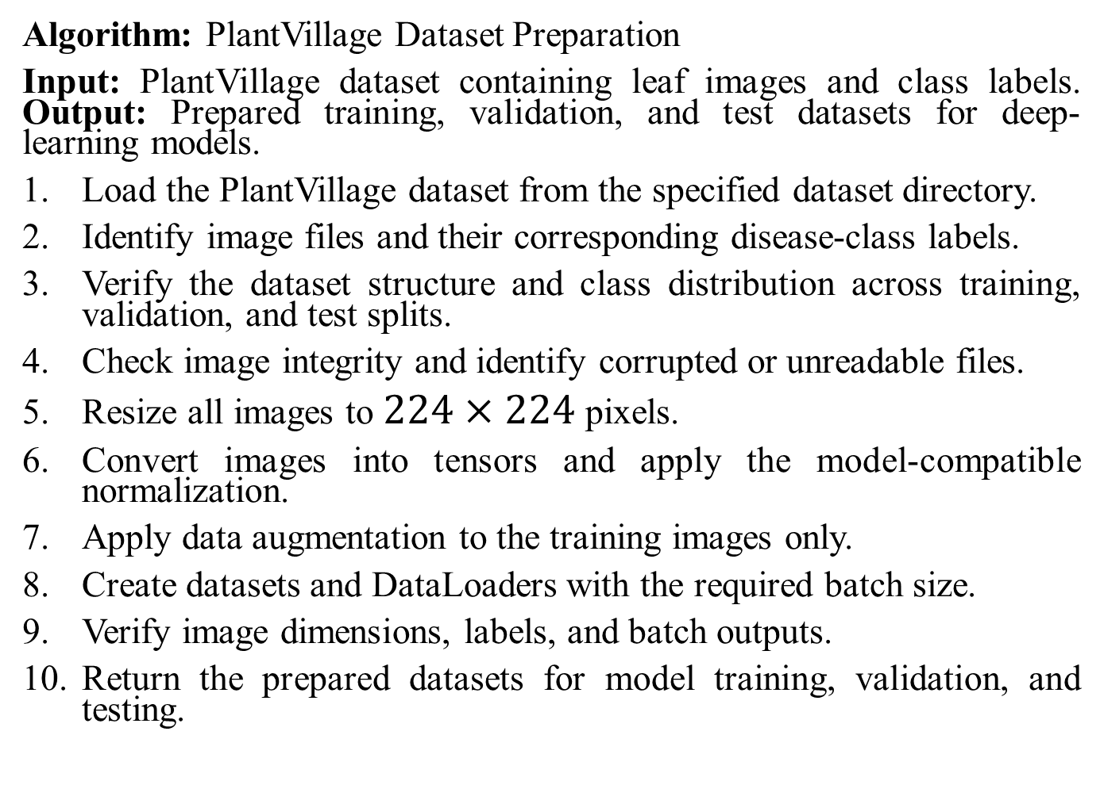
16.1 Data Preparation
Algorithm: PlantVillage Dataset Preparation
Input: PlantVillage dataset containing leaf images and class labels. Output: Prepared training, validation, and test datasets for deep-learning models.
Load the PlantVillage dataset from the specified dataset directory.
Identify image files and their corresponding disease-class labels.
Verify the dataset structure and class distribution across training, validation, and test splits.
Check image integrity and identify corrupted or unreadable files.
Resize all images to $224×224$pixels.
Convert images into tensors and apply the model-compatible normalization.
Apply data augmentation to the training images only.
Create datasets and DataLoaders with the required batch size.
Verify image dimensions, labels, and batch outputs.
Return the prepared datasets for model training, validation, and testing.

Slide 38
16.2 Data Preparation
ALGORITHM: PlantVillage Data Preparation
INPUT:
Dataset directory D
Image size S = (224, 224)
Batch size B
OUTPUT:
Training dataset D_train
Validation dataset D_val
Testing dataset D_test
BEGIN
1. Load dataset D
2. Verify class folders and image labels
3. Inspect dataset splits:
Train, Validation, Test
4. FOR each image I in D:
Check whether I is readable
IF I is corrupted:
Exclude I from processing
ELSE:
Resize I to 224 × 224
Convert I to tensor
Apply model-compatible normalization
END IF
END FOR
5. Apply data augmentation to training images only
6. Create dataset objects for each split
7. Create DataLoaders using batch size B
8. Verify image dimensions, labels, and batches
9. RETURN D_train, D_val, D_test
END

Slide 39
16.3 Data Preparation
INPUT
Plant Leaf Image Dataset (67,118 images; 29 classes)
Dataset Inspection
Directory structure, species, class labels and image counts
Image Integrity Validation
Open each file; detect corrupted images (0 found)
Split Verification
Train 53,693 · Val 12,067 · Test 1,358; 29 classes in each split
Image Resizing
Resize to 224 × 224 pixels
Normalization and Tensor Conversion
As required by the selected model or pretrained weights
Training-Only Augmentation
Training split only, where configured
Batching and DataLoader Creation
Batches with image–label mapping preserved
OUTPUT
Prepared training, validation and test data, ready for deep-learning model training and evaluation
Figure:. Data Preparation Pipeline for the PlantVillage Dataset.

Slide 40
17.1. Proposed System Architecture
TRAINING AND EVALUATION PHASE (offline)
PlantVillage Dataset
Kaggle · 67,118 images · 29 classes · 9 plant species
Dataset Preparation
Inspection, label check, integrity validation; resize 224 × 224; tensor + normalization; training-only augmentation
Candidate Architectures
ConvNeXt · EfficientNet · ResNet (candidate / comparative); transformer-based (candidate)
Selected Trained Models
M1 … MK chosen after comparison (proposed ensemble members)
INFERENCE PHASE (per uploaded image)
trained weights
INPUT: Leaf Image
User-provided plant leaf image
Image Validation
Readable, supported image? Invalid → error / retry message
Inference Preprocessing
Resize 224 × 224; tensor conversion; normalization (no augmentation)
Model Inference
Selected trained models M1 … MK → class scores
Abstention
No definitive disease label; uncertainty message
Reliable?
Reliability Assessment
Confidence, model agreement, uncertainty (proposed)
Ensemble Prediction
Combine model outputs (strategy: proposed)
unreliable
reliable
Final Output
Accepted prediction + reliability status + evidence, or abstention / uncertainty message
Agentic Evidence Retrieval
Supporting disease information from configured evidence source (proposed)
Dashed border = proposed component
Figure 3.5. Overall Architecture of the Proposed Plant Disease Recognition System.

Slide 41
17.2. Different Modules
Module 1 Name: Dataset Preparation and Image Preprocessing
1. Dataset loading, class-label verification, image integrity checks, and verification of the training, validation, and testing splits.
2. Image resizing to 224 × 224 pixels, tensor conversion, model-compatible normalization, and training-only augmentation.
Module 2 Name: Diverse Deep-Learning Model Training and Prediction
1. Train or evaluate the selected deep-learning architectures for plant disease classification using the prepared dataset.
2. Compare model predictions and classification performance before selecting the models or outputs used by the ensemble.
Module 3 Name: Ensemble Reliability Assessment and Abstention
1. Combine the selected model predictions using the specified or proposed ensemble strategy and assess prediction reliability.
2. Apply the defined reliability policy to accept a prediction or abstain when evidence is insufficient.
Module 4 Name: Agentic Evidence Retrieval and Result Presentation
1. Retrieve relevant plant-disease information through the evidence-retrieval component to support the presentation of an accepted prediction.
2. Present the disease prediction, available supporting evidence, and reliability or abstention status to the user.

Slide 42
17.3. Proposed Model
1. Plant Leaf Image Input
Image supplied for prediction
2. Image Validation
Readable and processable? Otherwise invalid-input message
3. Image Preprocessing
Resize 224 × 224 → tensor → normalization
4. Model Inference
Selected trained models → class probabilities / scores
5. Ensemble Prediction
Combine model outputs (proposed strategy)
6. Reliability Assessment
Confidence, agreement, uncertainty (where applicable)
7. Decision
Gate
8A. Accepted Prediction
Predicted plant disease identified
9. Agentic Evidence Retrieval
Supporting disease information from configured source (proposed)
10. Final Result
Prediction + reliability status + evidence, or uncertainty message
Prediction
accepted
Abstain
Offline data roles
Train: fit parameters · Val: model selection · Test: final evaluation only
8B. Abstention
No forced disease label
Figure 3.6. Proposed Model Pipeline for Abstention-Aware Plant Disease Recognition.

Slide 43
17.4. Algorithms/Pseudo Codes
Algorithm 1 Abstention-Aware Plant Disease Recognition with Agentic Evidence Retrieval
Input: Plant leaf image x; selected trained models M₁, …, M_{K}; ensemble strategy F; reliability function R; acceptance policy τ (only if threshold-based); evidence retrieval component E
Output: Accepted disease prediction ŷ with reliability status and supporting evidence, or an abstention result
1: Receive plant leaf image x
2: if x is not readable or not suitable for processing then
3: return invalid-input message
4: x′ ← Resize(x, 224 × 224)
5: x′ ← Normalize(ToTensor(x′)) ▷ model-compatible normalization
6: for k = 1 to K do p_{k} ← M_{k}(x′)
7: p ← F(p₁, p₂, …, p_{K})
8: ŷ ← argmax_{c} p_{c} ▷ valid when p holds class probabilities or comparable scores
9: r ← R(p₁, …, p_{K}, p) ▷ reliability from the adopted indicators
10: Apply the acceptance policy to r (using τ, if applicable)
11: if the prediction is accepted then
12: ev ← E(ŷ) ▷ if the evidence component is configured
13: return ŷ, reliability status, ev
14: else
15: return abstention status: no sufficiently reliable prediction obtained
16: end if
x: input image · x′: preprocessed image · M_{k}: k-th selected model · K: number of selected models · p_{k}: output of M_{k} · F: ensemble operation · p: combined output · c: class index · ŷ: candidate class · R: reliability assessment · r: reliability indicator(s) · τ: policy parameter (only if used) · E: evidence retrieval · ev: retrieved evidence

Slide 44
18.1. Experimental Setup
Table 1. Dataset and Preprocessing Configuration
Table 2. Experimental Environment and Tools
Parameter | Configuration
Dataset | PlantVillage (Kaggle: tushar5harma/plant-village-dataset-updated)
Total images | 67,118
Classes / species | 29 classes / 9 plant species
Training images | 53,693
Validation images | 12,067
Test images | 1,358
Input image size | 224 × 224 pixels
Image validation | File-open check; zero corrupted images found
Augmentation | Training split only, where configured
Component | Tool / configuration | Purpose
Language | Not specified | —
DL framework | Not specified | —
Dataset source | Kaggle | Image data
Environment | Google Colab* | Training / experiments
GPU | T4 GPU (Colab)* | Model training
CPU / RAM | Not specified | —
Batch size, optimizer | Not specified | Training settings
Learning rate, epochs | Not specified | Training settings
* used in at least one training session; not assumed for all experiments
Table 3. Evaluation Metrics and Validation Strategy
Table 4. Comparative Models
Metric / method | Purpose
Accuracy | Overall correct-classification rate
Precision, Recall, F1-score | Per-class classification quality
Confusion matrix | Class-wise error analysis
Model agreement | Consistency among selected models
Abstention measures (proposed) | Reliability-aware selective prediction
Training split | Update model parameters
Validation split | Model selection and tuning
Test split | Final evaluation only
Model | Role | Status
ConvNeXt | Comparative architecture | Candidate
EfficientNet | Comparative architecture | Candidate
ResNet | Comparative architecture | Candidate
Transformer-based | Candidate architecture | Considered
Ensemble of selected models | Proposed model | Proposed

